Slide 1
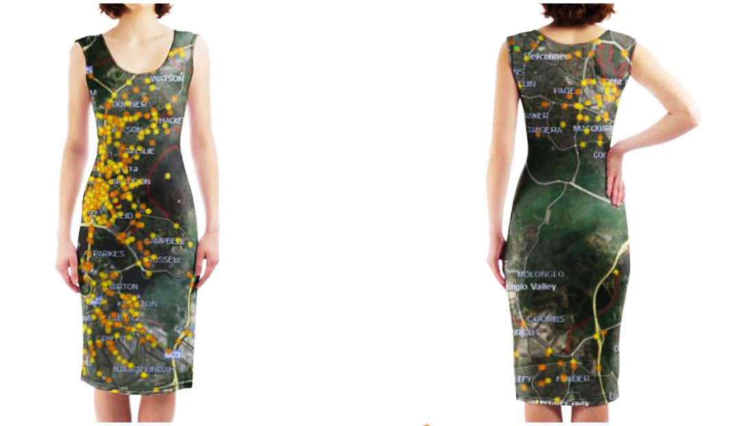
Beautiful Disaster:
For the ‘Data as Art’ challenge
By team Hack Yeah!
A superimposition of cycling crashes using geographic data onto a dress

